Slide 1

About the Company

Slide 2

Agenda
Story of the company
Project Deens.com
Your work Day
Your responsibilities
References

Slide 3
Story of the company
CoDeploy - Tech consulting company
Customers: startups, entrepreneurs, small and medium size businesses, media people (SMM)
Around 40 employees
Deens.com is on of the customers that have an entire agile team working on a project along with their own team
Was founded in 2012
Company has a couple of more major clients working primarily with Hospitality, Real Estate and Cannabis markets and a lot of small and temporary ones as well

Slide 4
References
IMPORTANT: Let us know ahead before sharing references
CodePloy, LLC
200 Spectrum Center Drive
Irvine, CA 92618
(714) 699-4530

Slide 5
Project Deens.com
Deens.com - marketplace that offers a fresh approach to book online travel; travellers can not only save hours but also customise trips across traditional (credit cards), decentralized (Blockchain technology), and sharing economies
Responsive Web Application
Mobile Application will be released this Spring
Rest API Web service
Serverless microservices architecture with API-first approach

Slide 6
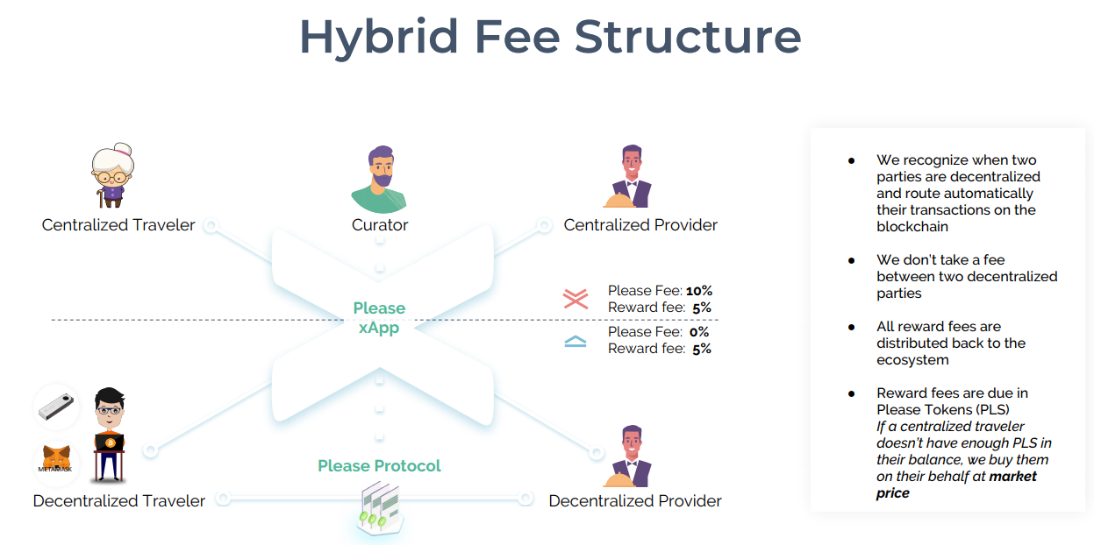
Project Deens.com

Slide 7
Your work Day
Review Emails and Slack messages
Review Bug fixes and open tickets assigned to you
Create test cases
Create new bug reports
Attending daily stand up meetings
Attending other meetings if scheduled

Slide 8
Your responsibilities
You were responsible for a quality, last frontier before sign off each release before pushing to production
QA Feature tickets and created defects if there were some
Collaboration with Team, Product Management and Developers
Actively participate in SDLC stages

Slide 9
SDLC
You worked in Agile with 2 weeks Scrums
After each 2 weeks You’ve had release and performed regression
Smoke on every build few builds a week
Attended all Scrum meetings (Grooming, Planning, Daily stand ups, Retrospective)

Slide 10
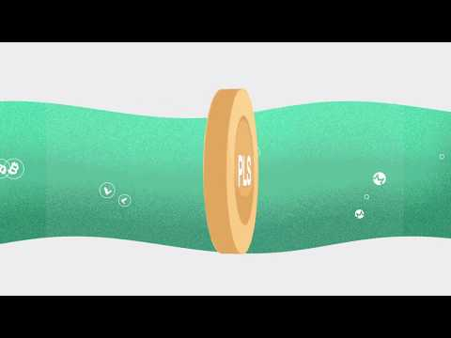
Resources
https://protocol.please.com/
https://protocol.please.com/assets/Please.com-Pitch-Deck.pdf
https://protocol.please.com/assets/Please.com-Whitepaper.pdf

Slide 11
Deens workflow
Feature building:
QA env - Smoke tests run
Staging environment - Full regression suit run
Production env accepting tests

